Slide 1
Capstone Engagement
Assessment, Analysis, and Hardening of a Vulnerable System

Slide 2
Table of Contents
This document contains the following sections:
01
Network Topology
02
Red Team: Security Assessment
03
Blue Team: Log Analysis and Attack Characterization
Hardening: Proposed Alarms and Mitigation Strategies
04

Slide 3
Network Topology
‹#›

Slide 4
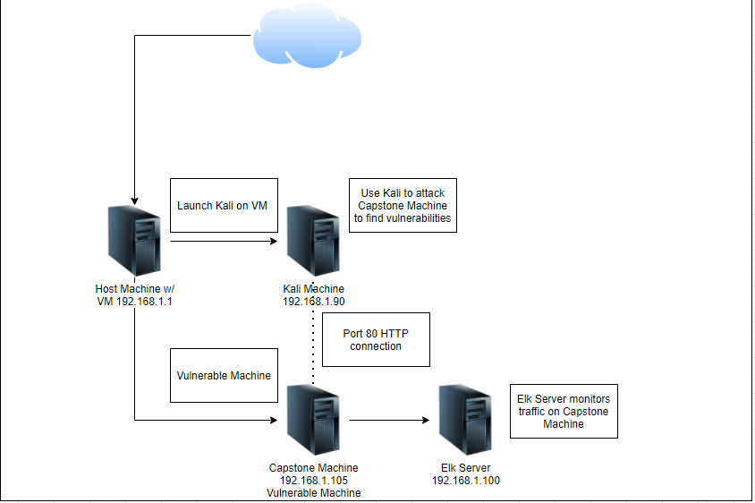
Network Topology
[Insert Here]
Use draw.io to create a diagram of the network.
Add your diagram to this slide and fill out the data in the sidebar.
Network
Address Range: 192.168.1.1/32
Netmask: 255.255.255.0
Gateway:
Machines
IPv4: 192.168.1.90
OS: Linux
Hostname: Kali Machine
IPv4: 192.168.1.105
OS: Linux
Hostname: Capstone Machine
IPv4: 192.168.1.100
Hostname: Elk Server
IPv4: 192.168.1.1
OS: Windows
Hostname: ML-REFVM-684427

Slide 5

Red Team
Security Assessment
‹#›

Slide 6
Recon: Describing the Target
Nmap identified the following hosts on the network:
Hostname | IP Address | Role on Network
ML-REFVM-684427 | 192.168.1.1 | Virtual Host with Hyper V
Kali | 192.168.1.90 | Attack Machine
ELK | 192.168.1.100 | Monitoring Machine that is hosting Kibaba and monitoring traffic through specific beats
Capstone Server | 192.168.1.105 | Vulnerable Machine

Slide 7
Vulnerability Assessment
The assessment uncovered the following critical vulnerabilities in the target:
Vulnerability | Description | Impact
Open Ports: Port 80 HTTP - Unsecure Webserver Port 22 SSH - Vulnerable to attack | Open ports allow for attackers to access machines without authority | Port 80 - gave us access to the Capstone’s private directories, access to the secret files Port 22 - SSH into the served with cracked passwords
Password susceptible to brute force | Passwords can be easily cracked when there are no rules in place to stop high volume traffic | Cracked Ashton’s password and see the confidential secret folder
Insecure Website: Secret files and hashed passwords found on public server | The website has plain text files with instructions on where the secret file is located and that file contained more information such as a password hash | We were able to find and crack Ryans password hash that gave us access to the weddav server
WebDav Vulnerability | Had the ability to upload files directly to WebDav | We were able to upload a reverse shell

Slide 8
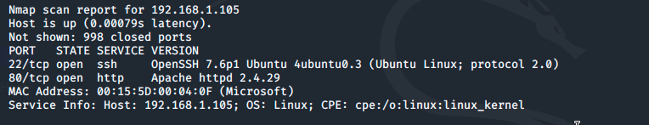
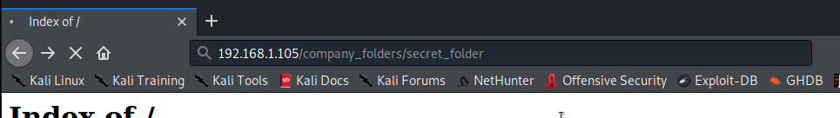
Exploitation: Open Port 80 - Insecure/Poor Website Management
01
02
03
Tools & Processes
Using NMAP we determined Port 80 was open on the vulnerable machine.
We were then able to navigate the the vulnerable site using the IP address 192.168.1.105.
Path Traversal.
Achievements
From the open site we were able to navigate through the sites file system and find documents with the mention of /company_folders/secret_folder.
The contents of which gave us information and instructions on how to access the company’s webdav instance.

Slide 9
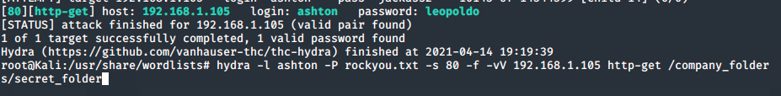
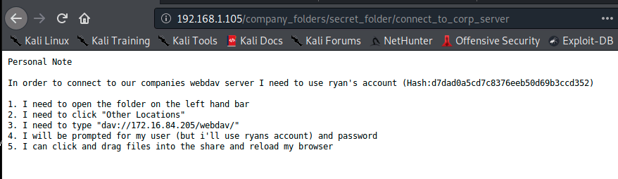
Exploitation: Susceptible to Brute Force
01
02
Tools & Processes
After determining the location of the /secret_folder we were able to navigate to the site and were prompted for a password.
Based off what we learned in the public facing documents we had obtained the username of Ashton.
Using a hydra command we were able to brute force the credentials
Achievements
Through navigating the site we were able to determine a good username could be aston.
Using hydra we determined Ashton’s password was leopoldo.
We then had access to the secret_folder and obtained Ryan’s Password Hash
03

Slide 10
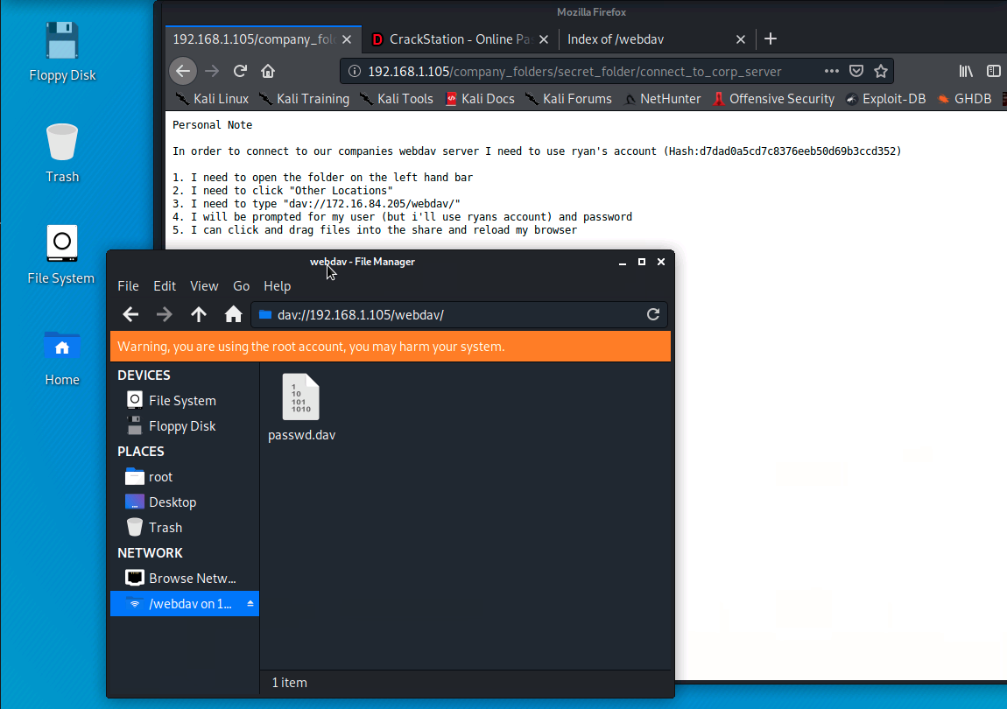
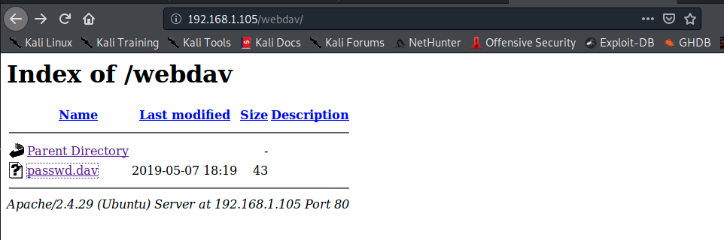
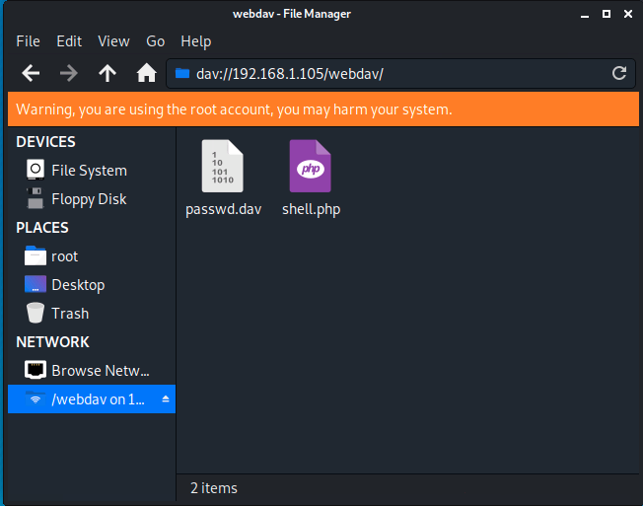
Exploitation: WebDav Access
01
02
03
Tools & Processes
Using the local file system and cracked password we were able to access the networks WebDav File.
From there we used MSFVenom to create a payload that will allow us to use a reverse shell.
Using WebDav we uploaded the reverse shell.
Achievements
We were able to gain access to the company’s WedDav File system.
Then we were able to upload a reverse shell payload and later exploit the machine.

Slide 11
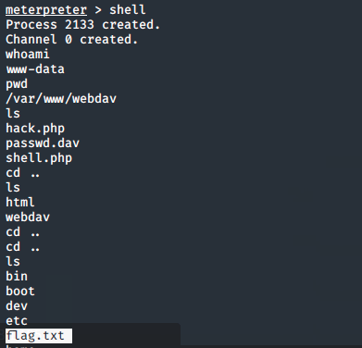
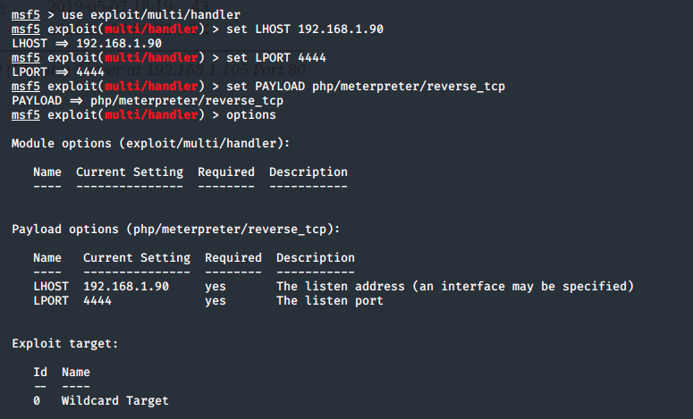
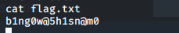
Exploitation: Exploiting the Reverse Shell
01
02
03
Tools & Processes
With the Payload attached to WebDav we then used Metasploit and Meterpreter.
Achievements
With the metasploit session listening, we were able to access the reverse shell and gain access to the target machine.
With access to the machine we were able to locate the flag

Slide 12

Blue Team
Log Analysis and Attack Characterization
‹#›

Slide 13

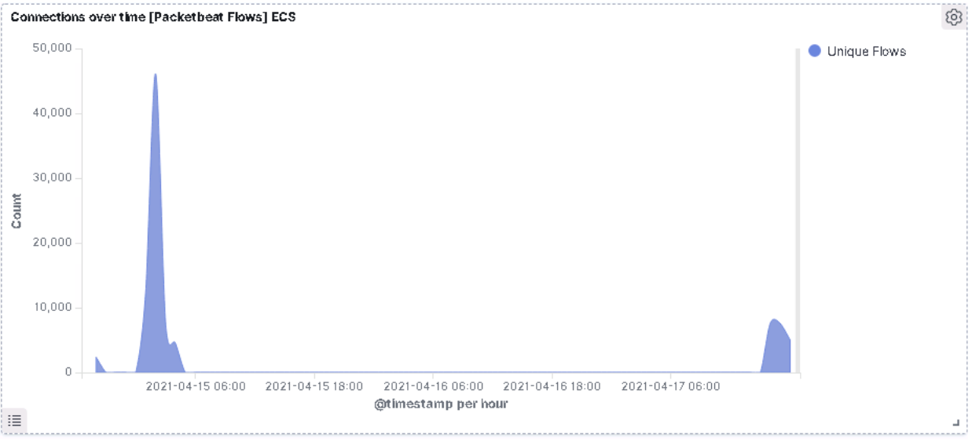
Analysis: Identifying the Port Scan
Answer the following questions in bullet points under the screenshot if space allows. Otherwise, add the answers to speaker notes.
What time did the port scan occur?
How many packets were sent, and from which IP?
What indicates that this was a port scan?
[Insert Here]
Include a screenshot of Kibana logs depicting the port scan.
Time of Port Scan: 02:00
Total Packets Sent: 45,000
The only spike that occurred between 2am - 3am indicates the port was scanned

Slide 14
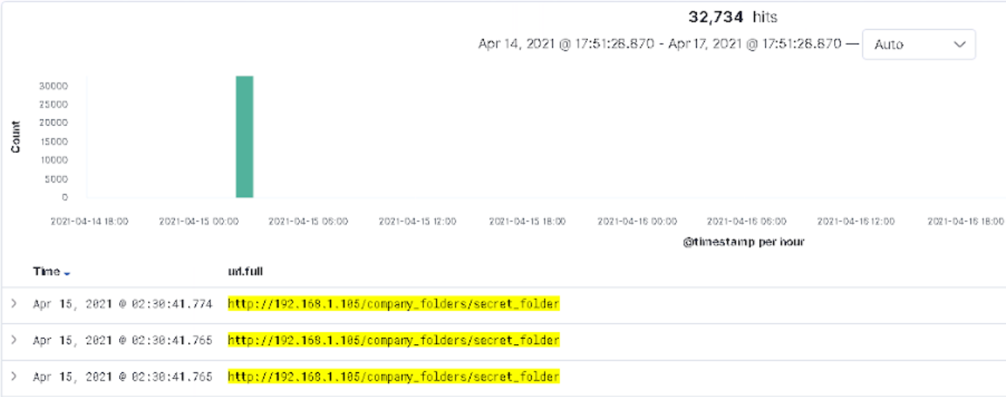
Analysis: Finding the Request for the Hidden Directory
Answer the following questions in bullet points under the screenshot if space allows. Otherwise, add the answers to speaker notes.
What time did the request occur? How many requests were made?
Which files were requested? What did they contain?
[Insert Here]
Include a screenshot of Kibana logs depicting the request for the hidden directory.
The Request occurred at 2am April 15, 2020
32,734 Requests were made
Files Requested: /company_folders/secret_folder
Files Contained: Company Information, Ryan’s Password Hash, and Instructions using WebDav

Slide 15
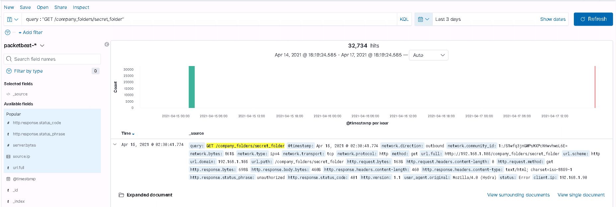
Analysis: Uncovering the Brute Force Attack
Answer the following questions in bullet points under the screenshot if space allows. Otherwise, add the answers to speaker notes.
How many requests were made in the attack? 32,734
How many requests had been made before the attacker discovered the password? 32,729
[Insert Here]
Include a screenshot of Kibana logs depicting the brute force attack.

Slide 16
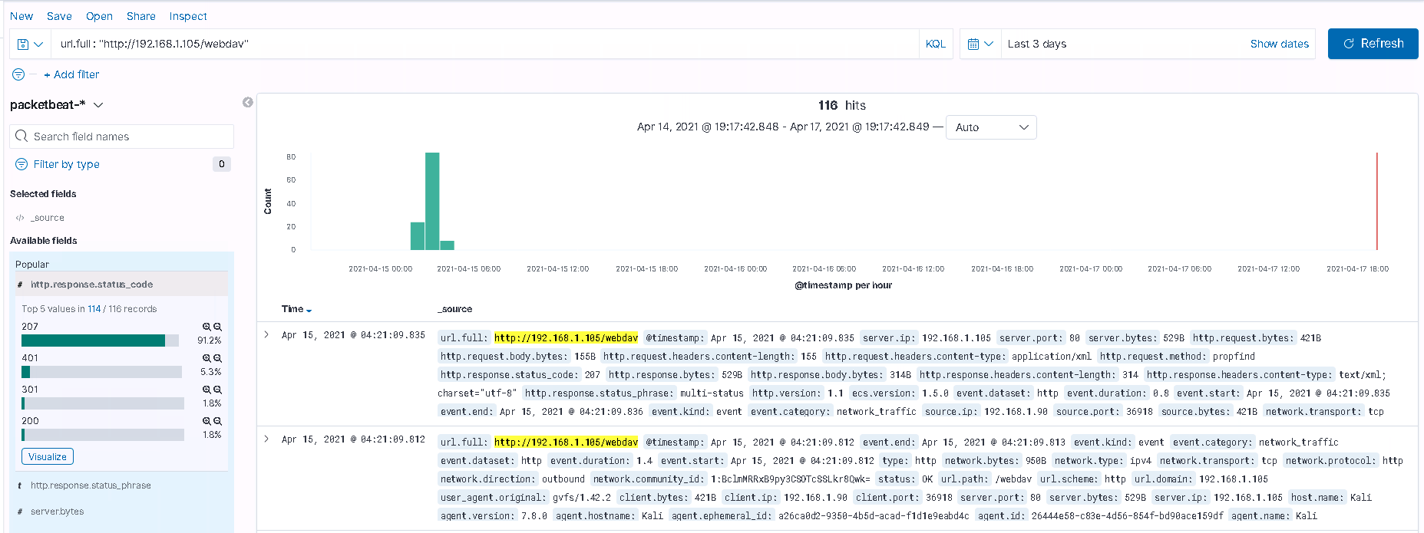
Analysis: Finding the WebDAV Connection
Answer the following questions in bullet points under the screenshot if space allows. Otherwise, add the answers to speaker notes.
How many requests were made to this directory? 116
Which files were requested? /company_folders/secret_folder
[Insert Here]
Add a screenshot of Kibana logs depicting the WebDAV connection.

Slide 17
Blue Team
Proposed Alarms and Mitigation Strategies
‹#›

Slide 18
Mitigation: Blocking the Port Scan
What kind of alarm can be set to detect future port scans?
Set up firewall alerts for high levels of ICMP request
Provide Administrators TCP Wrappers
https://www.datto.com/blog/what-is-port-scanning
What threshold would you set to activate this alarm?
More than 1000 ICMP requests per hour
What configurations can be set on the host to mitigate port scans?
Close as many ports as possible that are not used by usual traffic
Describe the solution. If possible, provide required command lines.
A possible solution could be using the command firewalld to check on the status of the ports:
sudo firewall-cmd --state

Slide 19
Mitigation: Finding the Request for the Hidden Directory
What kind of alarm can be set to detect future unauthorized access?
Email alerts if someone access the Hidden Directory.
Set up groups of authorized employees to access the Hidden Directory.
What threshold would you set to activate this alarm?
Send notifications if files are accessed, should only be available to internal users (employees)
What configuration can be set on the host to block unwanted access?
Whitelisting known employee IP addresses that log in most commonly
Block HTTP traffic from unknown IP address.
Restrict access to the Hidden Directory, should only be accessed by authorized users (employees)
Describe the solution. If possible, provide required command lines.

Slide 20
Mitigation: Preventing Brute Force Attacks
What kind of alarm can be set to detect future brute force attacks?
Set up alerts when there are too many attempts to login within a short-period of time. We have determined that an alert should be set for anytime the server returns over 20 HTTP error codes in the 400s within an hour
What threshold would you set to activate this alarm?
After 3 failed attempts lock the account
What configuration can be set on the host to block brute force attacks?
Utilize a two-step verification process to unlock the account and change the password
Utilize CAPTCHA
Set up a rule to change the password every 60 days
Maintain and patch WebDav to latest version
Set Limited user access

Slide 21
Mitigation: Detecting the WebDAV Connection
What kind of alarm can be set to detect future access to this directory?
An alert in place that notifies when there is over 15 requests per hour in /webdav/*
What threshold would you set to activate this alarm?
Allow only one user to use one IP
What configuration can be set on the host to control access?
Only allow certain users access to WebDav and set limits on uploads/downloads
i.e.: White Listing
Describe the solution. If possible, provide the required command line(s).
Maintain WebDav and patch to the newest version

Slide 22
Mitigation: Identifying Reverse Shell Uploads
What configuration can be set on the host to block file uploads?
Utilize a file blocker to block unwanted file uploads such as .php files
Require an authorization code or a password to upload content.
Describe the solution. If possible, provide the required command line.
Implement Incident Response protocols for the team to determine what the next steps are for when the traffic exceeds the limit
What kind of alarm can be set to detect future file uploads?
Set up an email alerts for any request to upload content.
What threshold would you set to activate this alarm?
Outbound traffic from server is greater than 20GB within 1 hour

